Slide 1
EGR7040-Final Project
Weight optimized SLA 3D printed pressure vessel cylinder
Jack Young

Slide 2
Candidate Design Problem
Maximize Fx
x1 =ro,x2=ro,x3=Pi,x4=Po,x5=Pcr
Fx = ((Pi*ri^2-Po*ro^2)/(ro^2-ri^2))-Pcr
g1=ro-ri-.002meters<=0
g2=po-pi-pcr<=0
-ri>0
-ro>0

Slide 3
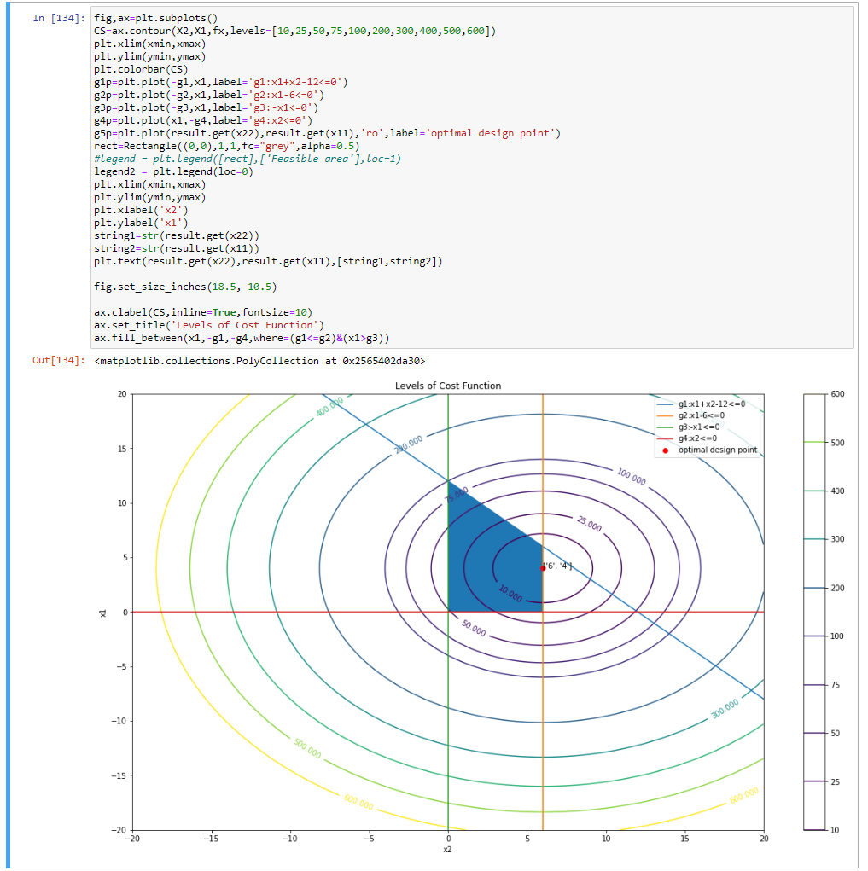
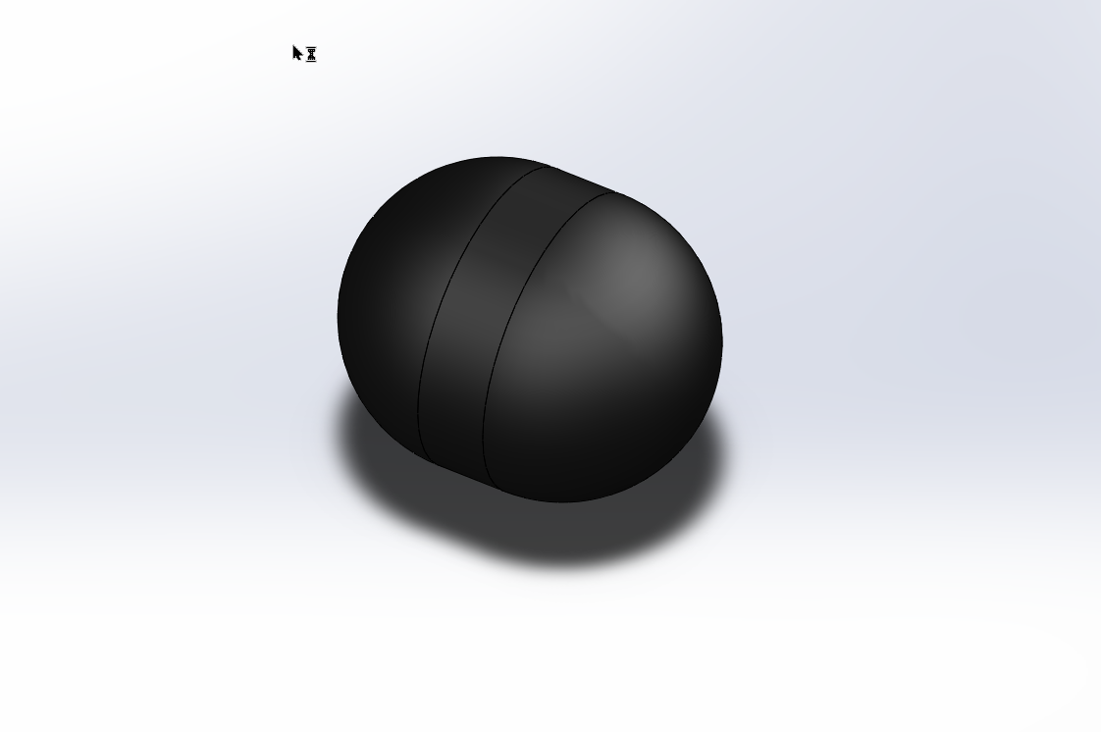
Graphs
Price increases as volume goes up
Code needs updated spent extra
time learning python syntax

Slide 4
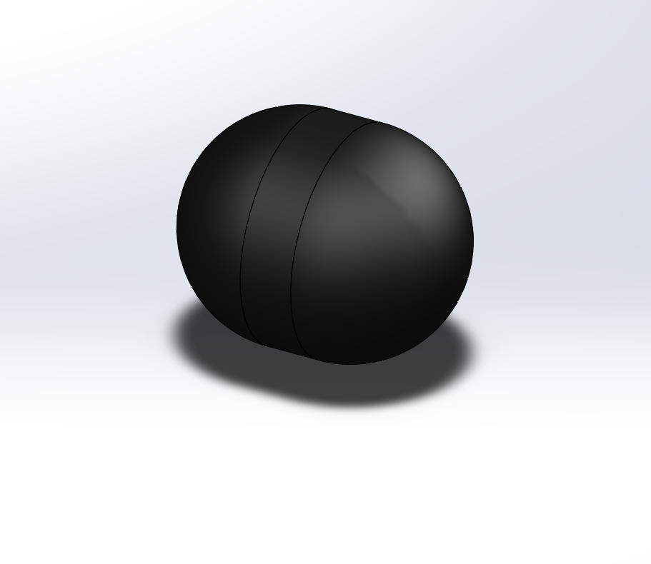
Cost
Cost of the item is directly correlated to:
  Mass
  Electricity used
    Neglected in this study

Slide 5
Potential problems
The actual yield stress of the PLA used to print the item will vary from manufacturer to manufacturer around some range of values for Pcritical

